Slide 1

Programming One (csc7050)
Aidan McGowan
OOP - Inheritance

Slide 2
Inheritance - intro
Inheritance, which is a form of software reuse in which a new class is created by absorbing an existing class’s members and embellishing them with new or modified capabilities.
With inheritance, you can save time during program development by basing new classes on existing proven and debugged high-quality software. This also increases the likelihood that a system will be implemented and maintained effectively.

Slide 3
Inheritance - intro
When creating a class, rather than declaring completely new members, you can designate that the new class should inherit the members of an existing class. The existing class is called the superclass and the new class is the subclass.
Superclass
Subclass

Slide 4
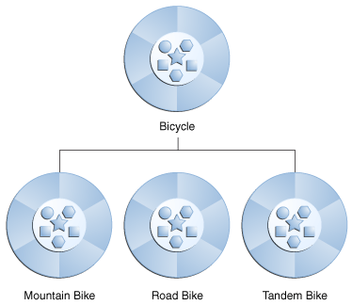
Inheritance - intro
A subclass can add its own fields and methods. Therefore, a subclass is more specific than its superclass and represents a more specialized group of objects. The subclass exhibits the behaviours of its superclass and can modify those behaviours so that they operate appropriately for the subclass.

Slide 5
Inheritance - intro
In Java, the class hierarchy begins with class Object (in package java.lang), which every class in Java directly or indirectly extends (or “inherits from”).
Java supports only single inheritance, in which each class is derived from exactly one direct superclass.

Slide 6
Inheritance - intro
We distinguish between the is-a relationship and the has-a relationship. Is-a represents inheritance. In an is-a relationship, an object of a subclass can also be treated as an object of its superclass—e.g. a car is a vehicle.
By contrast, has-a represents composition. In a has-a relationship, an object contains as members references to other objects— e.g., a car has a steering wheel (and a car object has a reference to a steering-wheel object).

Slide 7
Inheritance – hierarchy
Shape
superclass
Triangle
Rectangle
Sphere
Cube
subclass
The is a relationship is represented by the arrow
Triangle is a Shape. Rectangle is a Shape etc.

Slide 8
Inheritance – hierarchy
Animal
Mammal
Reptile
Fish
Amphibians
Arthropods
Human
Dog
Mammal is a Animal. Human is a Mammal and is a Animal

Slide 9
has-a relationship
Not every class relationship is an inheritance relationship. The has-a relationship, in which classes have members that are references to objects of other classes. Such relationships create classes by composition of existing classes.
For example, given the classes Employee, BirthDate and TelephoneNumber, it’s improper to say that an Employee is a BirthDate or that an Employee is a TelephoneNumber.
However, an Employee has a BirthDate, and an Employee has a TelephoneNumber.

Slide 10
Superclass and subclass
It’s possible to treat superclass objects and subclass objects similarly—their commonalities are expressed in the superclass’s members.
Objects of all classes that extend a common superclass can be treated as objects of that superclass—such objects have an is-a relationship with the superclass.
A subclass can customise methods that it inherits from its superclass. To do this, the subclass overrides (redefines) the superclass method with an appropriate implementation.

Slide 11
Inheritance – case study
StaffMember
- firstName : String - lastName : String
+ getFirstName() : String + setFirstName(firstName: String) + getLastName() : String + setLastName(lastName: String) + toString() : String
Firstly the UML class diagram for a StaffMember class to represent a employee in a hospital staff record application system.

Slide 12
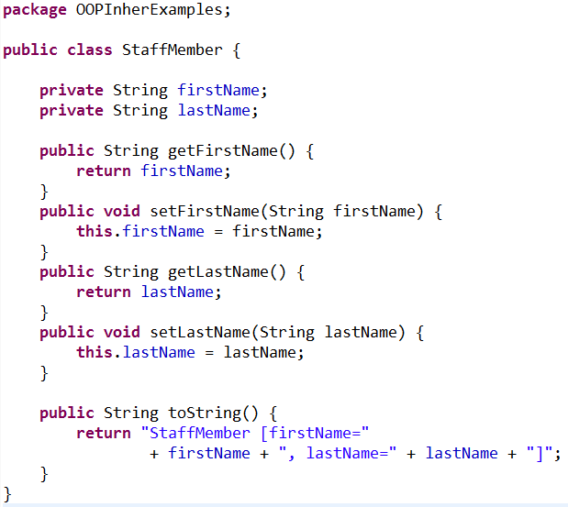
StaffMember coded
Instance variables
Getters and Setters for the Instance variables
toString() method

Slide 13
Class hierarchy
StaffMember
superclass
Doctor
Programmer
subclasses

Slide 14
Inheritance – case study
StaffMember
- firstName : String - lastName : String
+ getFirstName() : String + setFirstName(firstName: String) + getLastName() : String + setLastName(lastName: String) + toString() : String
Doctor
- ward : int
+ getWard() : int + setWard(wardNumber: int) + toString() : String
Programmer
- language: String
+ getLanguage () : String + setLanguage (language: String) + toString() : String

Slide 15
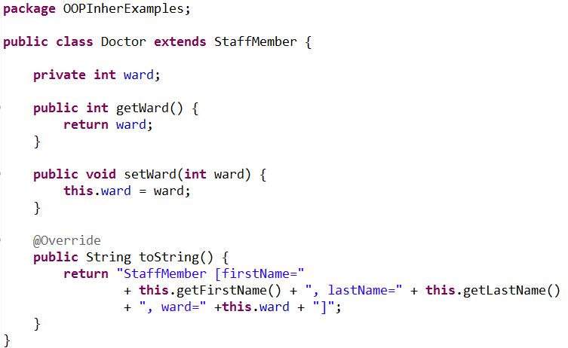
Doctor class
The extends keyword means that this class extends another. In this case Doctor extends StaffMember
toString method but this version belongs to the Doctor class and outputs information that relate specifically to the Doctor class. It Overrides the superclass method

Slide 16
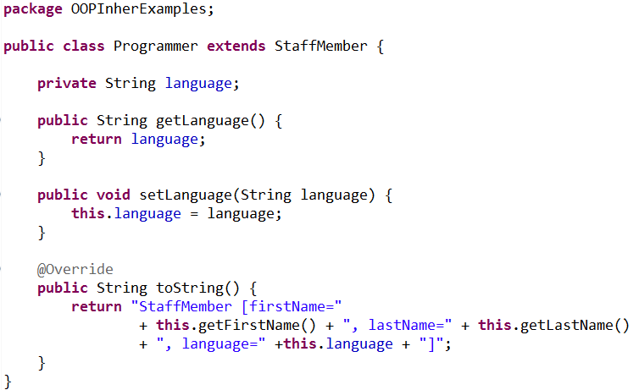
Programmer class
extends StaffMember.
toString method again Overrides the superclass method and includes details specific to the programmer class

Slide 17
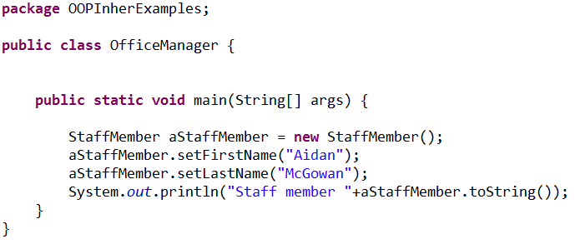
Test run….
Creating a class with a main method to test out the application
Creating the superclass

Slide 18
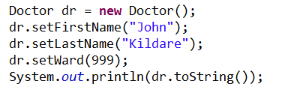
Test run…. Creating a Doctor
Creating the Doctor class
Setting and then outputting
the details

Slide 19
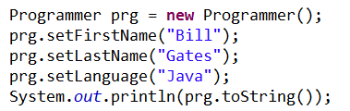
Test run…. Creating a Programmer
Creating the Programmer class
Setting and then outputting
the details

Slide 20
So why bother with Inheritance ?
Minimise the amount of duplicate code in an application by sharing common code amongst several subclasses
Reduces development time
Tends to result in a better organisation of code and smaller, simpler compilation units.
More robust code (reuse of tested and therefore trusted code)
Flexible to change – changing superclass will update subclasses

Slide 21
OOP Inheritance exercise I
Vehicle
- name : String - powerType : String
+ getName() : String + setName(name: String) + getPowerType() : String + setPowerType (powerType: String) + toString() : String
Car
- numberOfWheels: int
+ getNumberOfWheels () : int + setNumberOfWheels (numberOfWheels: int) + toString() : String
Ship
- tonnage : int
+ getTonnage () : int + setTonnage (tonnage : int) + toString() : String
Notes:
package OOPInhertance;
public class Vehicle {
private String name;
private String powerType;
/**
* Default constructor
*/
public Vehicle(){
}
/**
* Constructor with args
* @param name
* @param powerType
*/
public Vehicle(String name, String powerType){
this.name = name;
this.powerType = powerType;
}
/**
* @return the name
*/
public String getName() {
return name;
}
/**
* @param name the name to set
*/
public void setName(String name) {
this.name = name;
}
/**
* @return the powerType
*/
public String getPowerType() {
return powerType;
}
/**
* @param powerType the powerType to set
*/
public void setPowerType(String powerType) {
this.powerType = powerType;
}
@Override
public String toString() {
return "Vehicle [name=" + name + ", powerType=" + powerType + "]";
}
}
_____________________________________________________________________________________
package OOPInhertance;
public class Ship extends Vehicle {
private int tonnage;
public Ship(){
}
/**
* Constructor with args
* @param name
* @param powerType
*/
public Ship(String name, String powerType, int tonnage){
this.setName(name);
this.setPowerType(powerType);
this.tonnage = tonnage;
}
/**
* @return the tonnage
*/
public int getTonnage() {
return tonnage;
}
/**
* @param tonnage the tonnage to set
*/
public void setTonnage(int tonnage) {
this.tonnage = tonnage;
}
@Override
public String toString() {
return "Ship [ name="+ this.getName() +" powertype=" +this.getPowerType() +" tonnage=" + tonnage + "]";
}
}
_______________________________________________________________________________________
package OOPInhertance;
public class Car extends Vehicle {
private int numberOfWheels;
/**
* default constructor
*
*/
public Car() {
}
/**
* Constructor with args
*
* @param name
* @param powerType
*/
public Car(String name, String powerType, int numberOfWheels) {
this.setName(name);
this.setPowerType(powerType);
this.numberOfWheels = numberOfWheels;
}
/**
* @return the numberOfWheels
*/
public int getNumberOfWheels() {
return numberOfWheels;
}
/**
* @param numberOfWheels
* the numberOfWheels to set
*/
public void setNumberOfWheels(int numberOfWheels) {
this.numberOfWheels = numberOfWheels;
}
@Override
public String toString() {
return “Car [ name=" + this.getName() + " powertype="
+ this.getPowerType() + " numberOfWheels=" + numberOfWheels
+ "]";
}
}

Slide 22





OOP Inheritance exercise II
Create and then extend the Animal class to create new subclasses for each of the specific animal types. Include at least one field specific to each animal type. E.g. Bird may have a field relating to wing span.
Animal
name : String noise : String eyeColour : String
+ makeNoise ()
Notes:
package InhertExamples;
/**
* Superclass - represents a generic animal
* @author amcgowan
*/
public class Animal {
/**
* Name of the animal
*/
private String name;
/**
* The noise of the animal makes
*/
private String noise;
/**
* Default constructor
*/
public Animal(){
}
/**
* Constructor with args
* @param name
* @param noise
*/
public Animal(String name, String noise){
this.name = name;
this.noise = noise;
}
/**
* @return the name
*/
public String getName() {
return name;
}
/**
* @param name the name to set
*/
public void setName(String name) {
this.name = name;
}
/**
* Outputs the noise the animal makes
*/
public void makeNoise(){
System.out.println(this.name + " goes " +this.noise);
}
/**
* @return the noise
*/
public String getNoise() {
return noise;
}
/**
* @param noise the noise to set
*/
public void setNoise(String noise) {
this.noise = noise;
}
/**
* Returns the details of the object
*/
public String toString() {
return "Animal [name=" + name + ", noise=" + noise + "]";
}
}
________________________________________________________________________________________________________________
package InhertExamples;
/**
* Dog class based on Animal class...
* @author amcgowan
*/
public class Dog extends Animal {
private int licenseNumber;
/**
* Default constructor
*/
public Dog(){
}
/**
* Constructor with args
* @param name
* @param noise
* @param licenseNumber
*/
public Dog(String name, String noise, int licenseNumber) {
this.setNoise(noise);
this.setName(name);
this.licenseNumber = licenseNumber;
}
/**
* @return the licenseNumber
*/
public int getLicenseNumber() {
return licenseNumber;
}
/**
* @param licenseNumber the licenseNumber to set
*/
public void setLicenseNumber(int licenseNumber) {
this.licenseNumber = licenseNumber;
}
/**
* Returns the object's details
*/
@Override
public String toString() {
return super.toString() + "Dog [licenseNumber=" + licenseNumber + "]";
}
}

